Slide 1
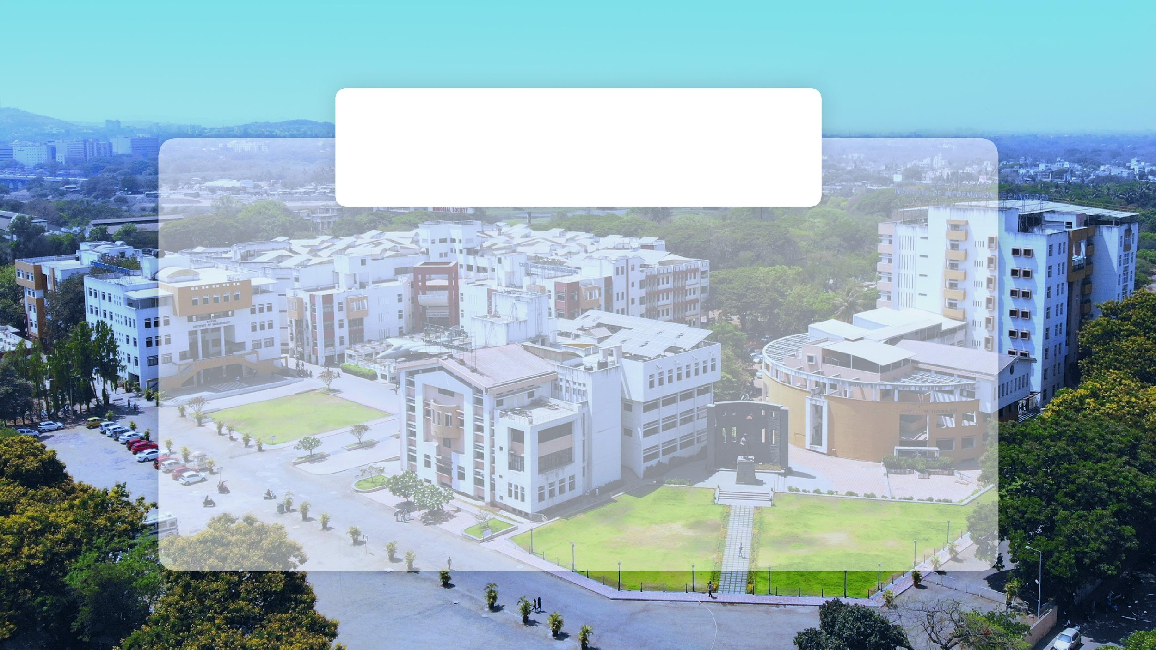

A Presentation
On
Parking Detection and Obstacle Notification System
By Team name
39. PRANJALI GANGARDE
47. SAKSHI GUDADE
Guided By : Dr. Vineeta Philip

Slide 2

Points to be Discussed
Introduction
Motivation
Problem Definition
Aim & Objectives
Project Scope
Literature Survey
Methodology
Details of Components
Expected Outcomes
References
Problem Definition
Introduction
Aim & Objectives
Project Scope
Selection of Components
Block Diagram
Flowchart
Expected Outcomes
References

Slide 3

PROBLEM DEFINITION
Unauthorized parking in restricted areas leads to traffic disruptions and inconvenience due to inefficient monitoring systems. The reliance on manual enforcement is time-consuming, prone to errors, and resource-intensive. Additionally, the absence of a real-time notification system delays communication with vehicle owners, while manual challan generation can cause discrepancies. This results in poor compliance with parking rules, necessitating an automated solution to address these challenges effectively.

Slide 4


INTRODUCTION
1. The project addresses the issue of unauthorized parking in non-parking zones.
2. Uses technologies like IR sensors, RFID, and the Blynk application for automation.
3. Automates detection, notification, and challan generation processes.
4. Triggers a buzzer alert for violations and sends real-time notifications to vehicle owners.
5. Aims to reduce manual effort, enhance compliance, and ensure efficient parking management.
6. Provides a scalable and cost-effective prototype for broader implementation.

Slide 5
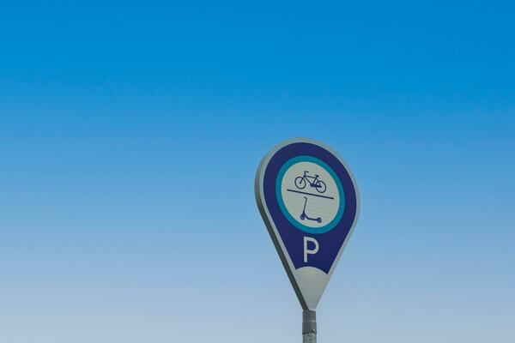

Aim of Project
To design an automated system that detects unauthorized parking in non-parking zones, issues real-time notifications, and reduces manual intervention using IR sensors, RFID, and the Blynk application.

Slide 6
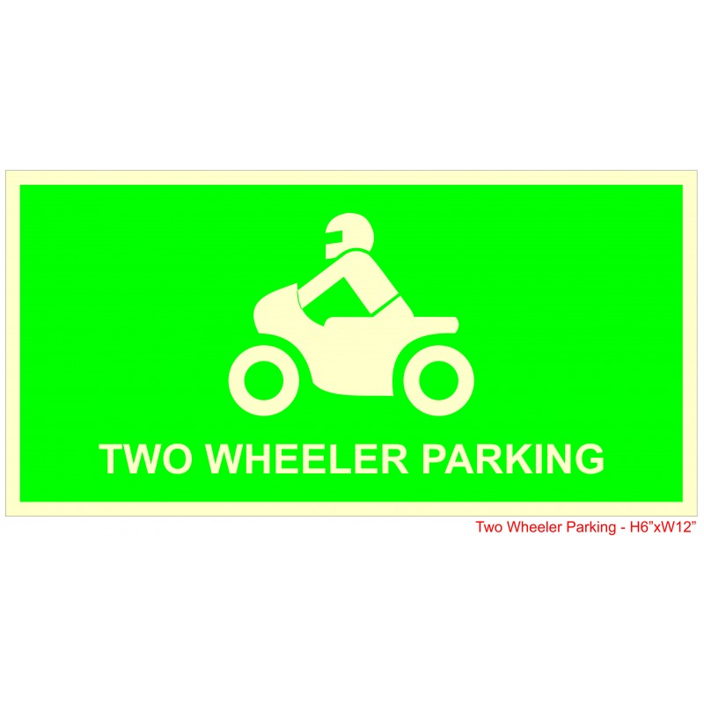
OBJECTIVES
Objectives of Study
Detect Unauthorized Parking: Use sensors to identify vehicles in restricted zones.
Trigger Alerts: Sound a buzzer to notify about parking violations.
Automate Challan Generation: Implement RFID technology for efficient challan creation.
Send Real-time Notifications: Use the Blynk app to inform vehicle owners immediately.
Reduce Manual Effort: Minimize human intervention in monitoring and enforcin rules.
Enhance Compliance: Encourage adherence to parking regulations through automation.
Develop a Scalable System: Create a prototype that can be expanded for large-scale implementation

Slide 7
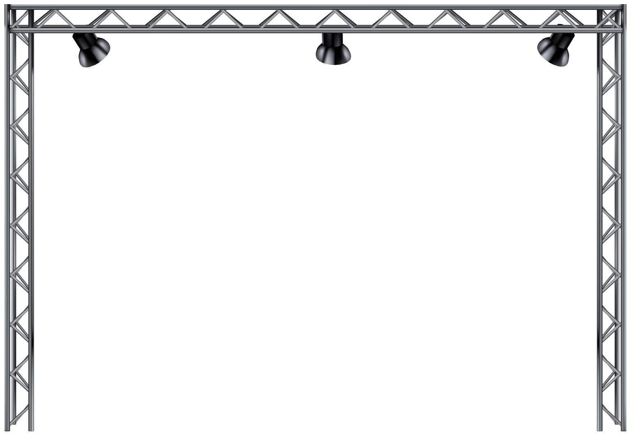
Project Scope
Unauthorized Parking Detection using IR and ultrasonic sensors.
Automated Challan Generation via RFID technology.
Real-time Notifications to vehicle owners through Blynk App.
Development of a scalable and cost-effective prototype.
Integration potential with smart city systems for better traffic management

Slide 8
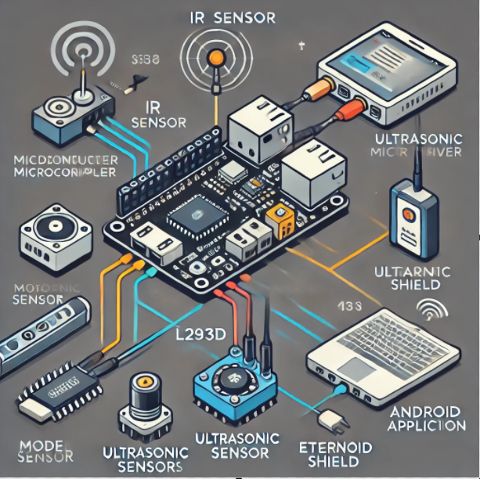
Selection Of Components
ESP32 Node MCU
RFID MODULE
IR SENSOR
BUZZER
ETHERNET SHIELD
L293D DRIVER
DC MOTOR

Slide 9

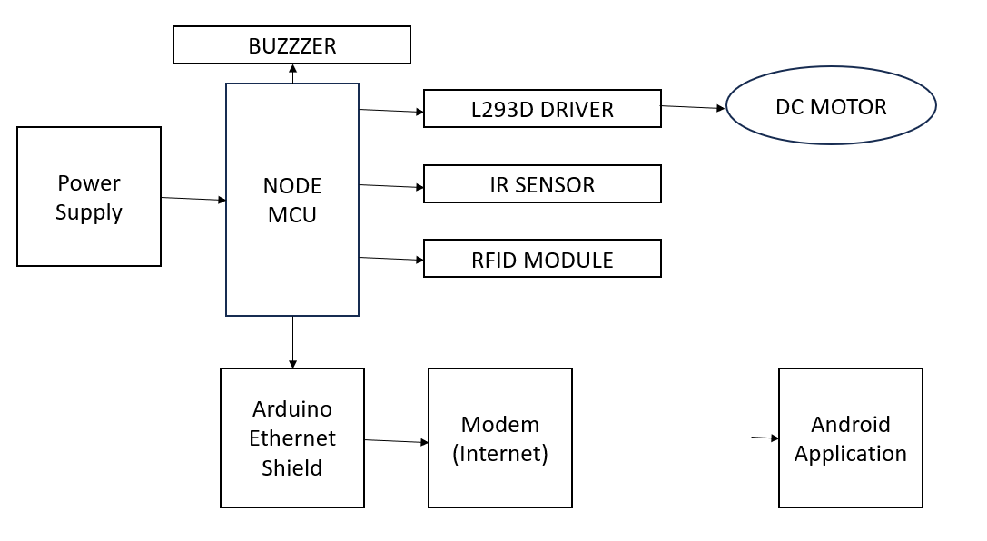
BLOCK DIAGRAM

Slide 10
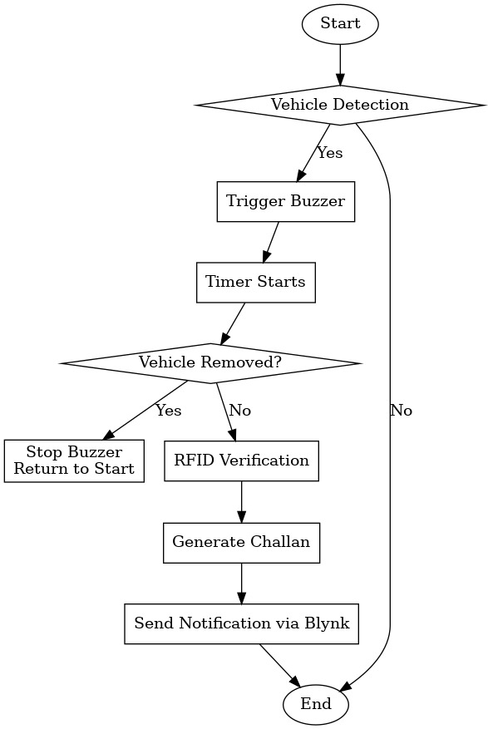
FLOW CHART

Slide 11

EXPECTED OUTCOMES
Real-time detection of parking violations.
Automated challan process with reduced manual monitoring.
Instant alerts via Blynk app to vehicle owners.
Improved compliance with parking regulations.
A scalable system suitable for broader deployment

Slide 12

REFERENCES
References
IoT-Based Parking Management System – IEEE Research Paper.
Arduino and Sensor Documentation (www.arduino.cc).
Blynk Development Resources (www.blynk.io).
RFID Overview – Electronics Hub (www.electronicshub.org).
Ultrasonic Sensor Applications – SparkFun (www.sparkfun.com).

Slide 13


